Slide 1
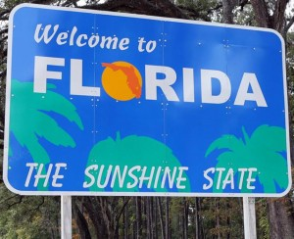
Presented by:
David Glauber Shawn Ohtani
Meghan Brunelli Arlene Haessler

Slide 2
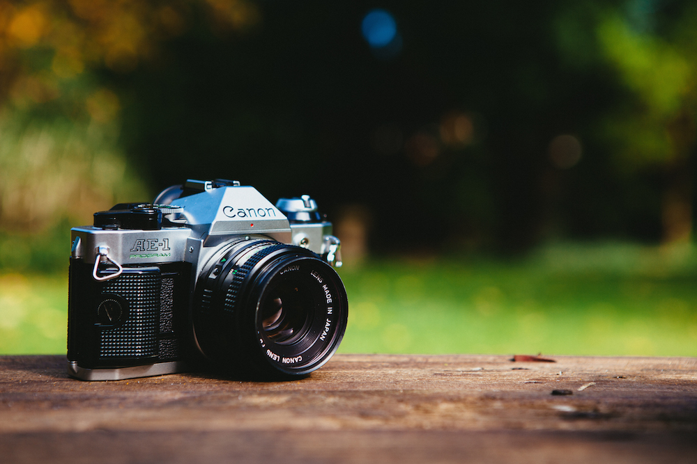
Planning to Travel
Learn the History
Become Acquainted before Travelling
Download Apps
Pocket Ranger
Maps of State Parks
Tripcast
Create a Travel Journal
Photography
Read Tips on Taking Creative Photos
Photograph Scenery
Tell a Story with Pictures

Slide 3
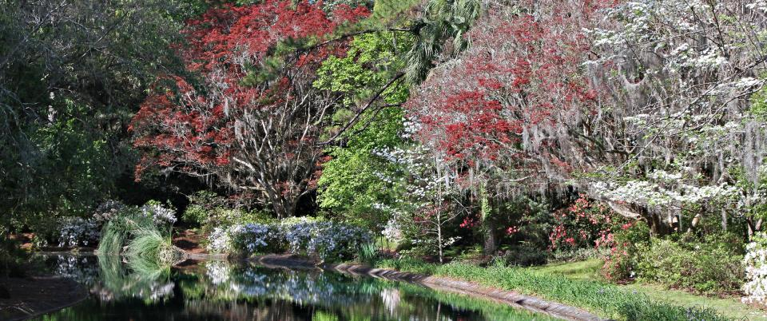
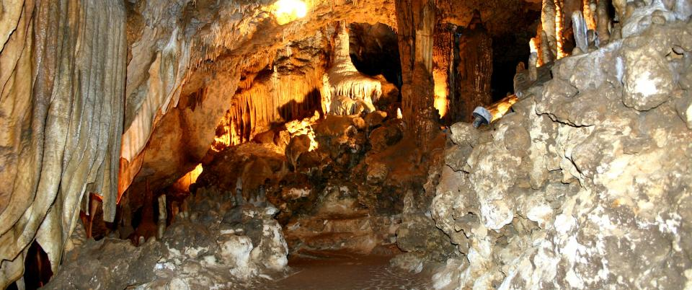
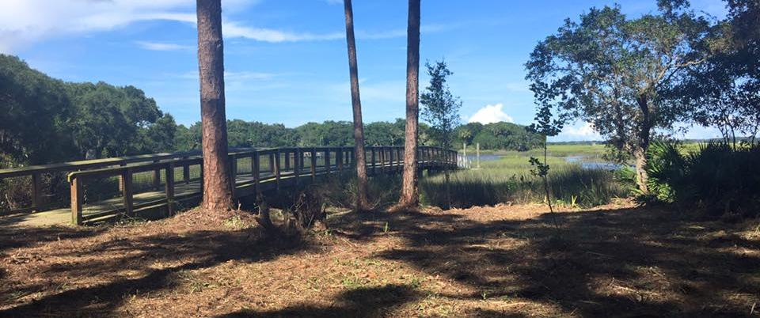
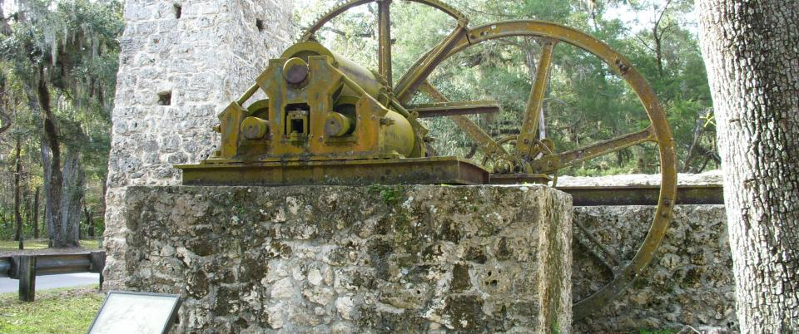
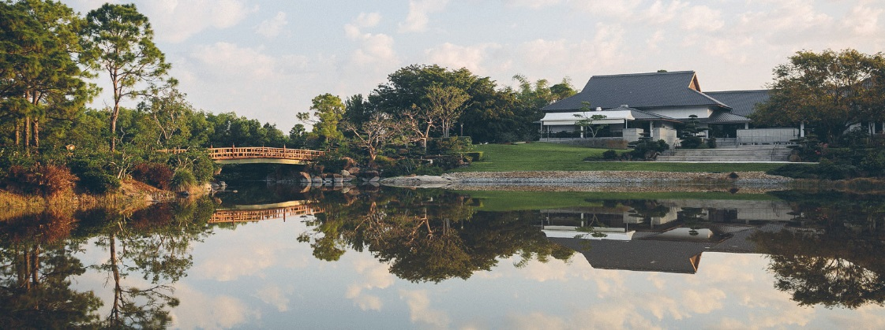
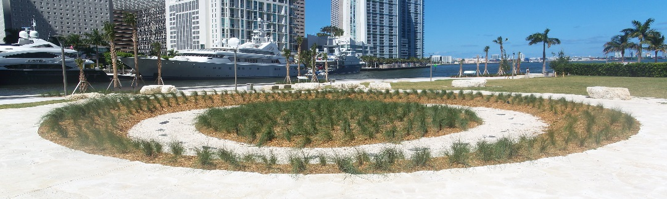
Fountain of Youth, St. Augustine, FL
Kennedy Space Center, Cape Canaveral, FL
Maclay Gardens State Park, Tallahassee, FL
Florida Caverns State Park, Marianna, FL
Fort Mose, St. Augustine, FL
Yulee Sugar Mill Ruins, Homosassa, FL
Morikami Museum , Delray Beach, FL
Miami Circle, Miami, FL

Slide 4
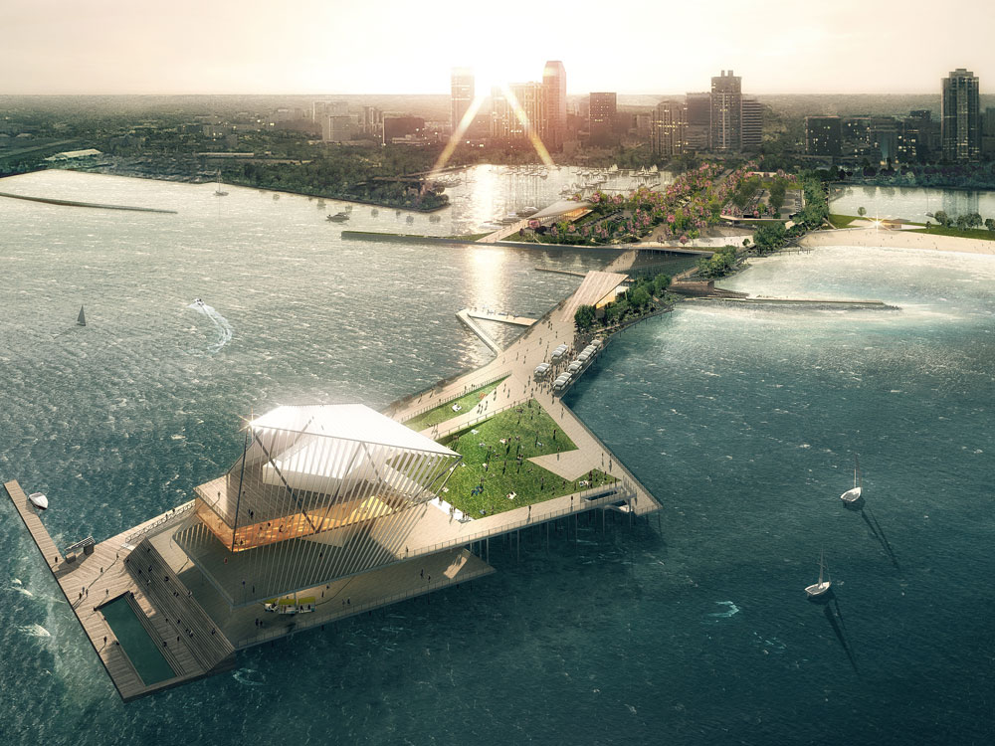
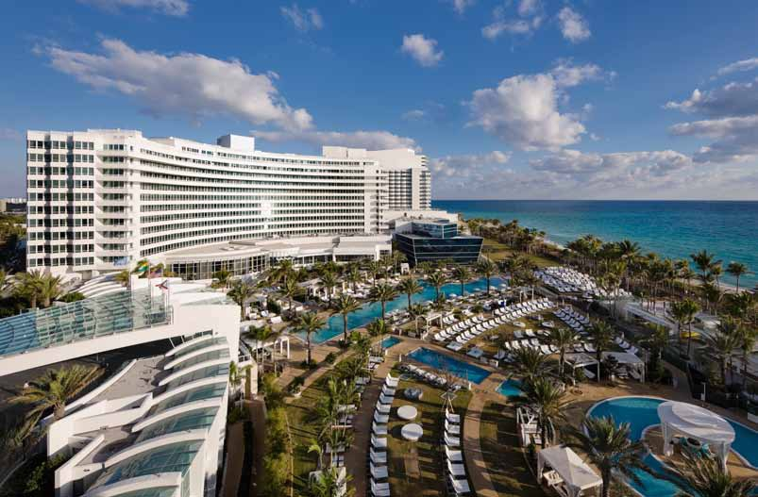
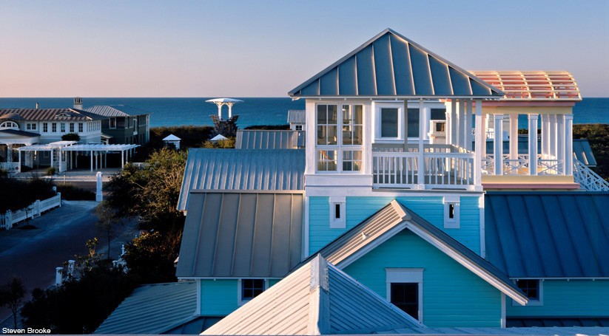
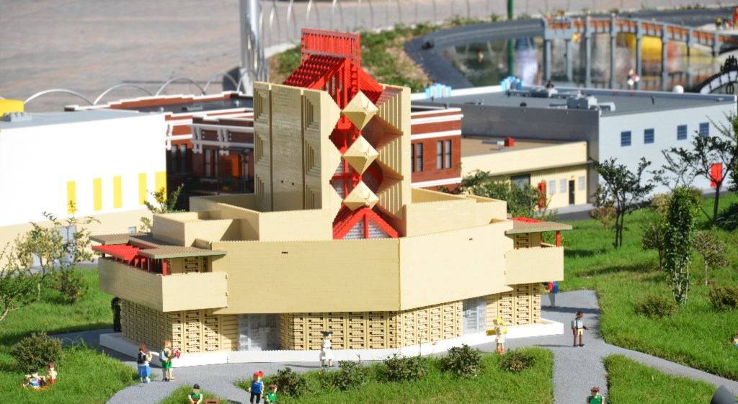
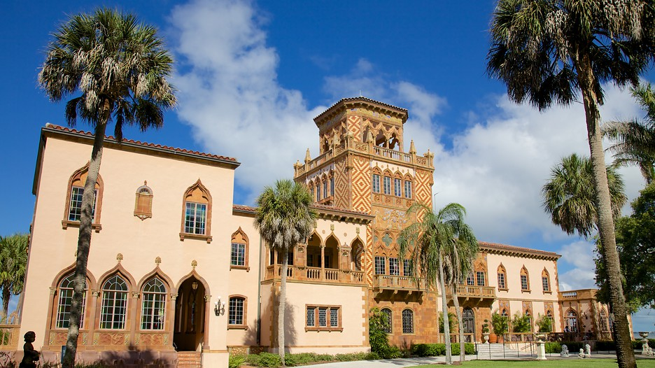
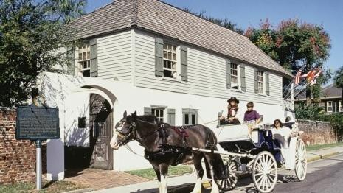
St. Petersburg Pier
Fountainbleau, Miami Beach, FL
Florida Architecture
Seaside, FL
Annie Pfeiffer Chapel, Lakeland, FL
Ringling Museum, Sarasota, FL
Oldest House, St. Augustine, FL

Slide 5
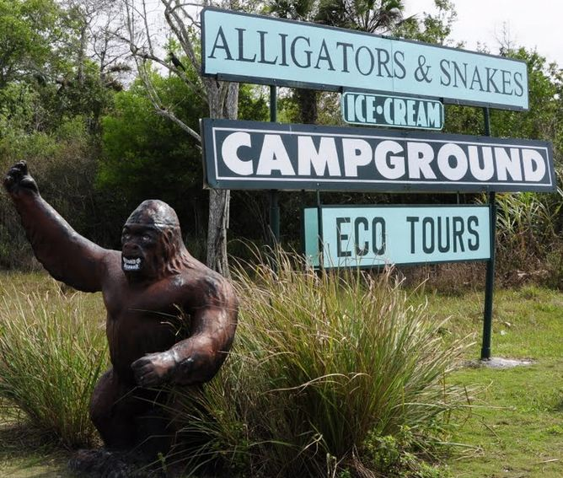
Skunk Ape Research Headquarters
Big Cypress National Preserve

Slide 6
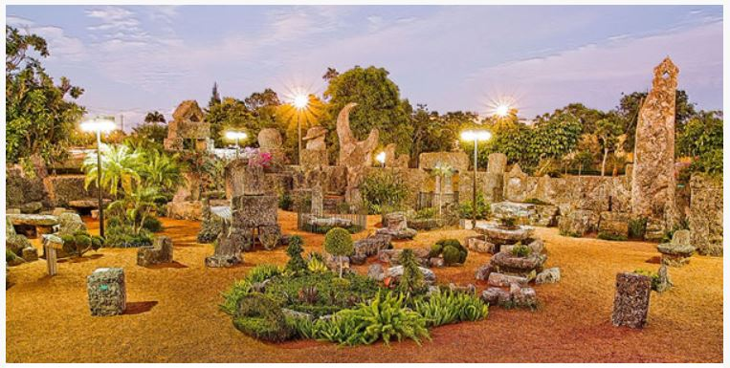
Weird Florida
Coral Castle Museum
Miami, FL

Slide 7
Solomon’s Castle
Ona, FL

Slide 9
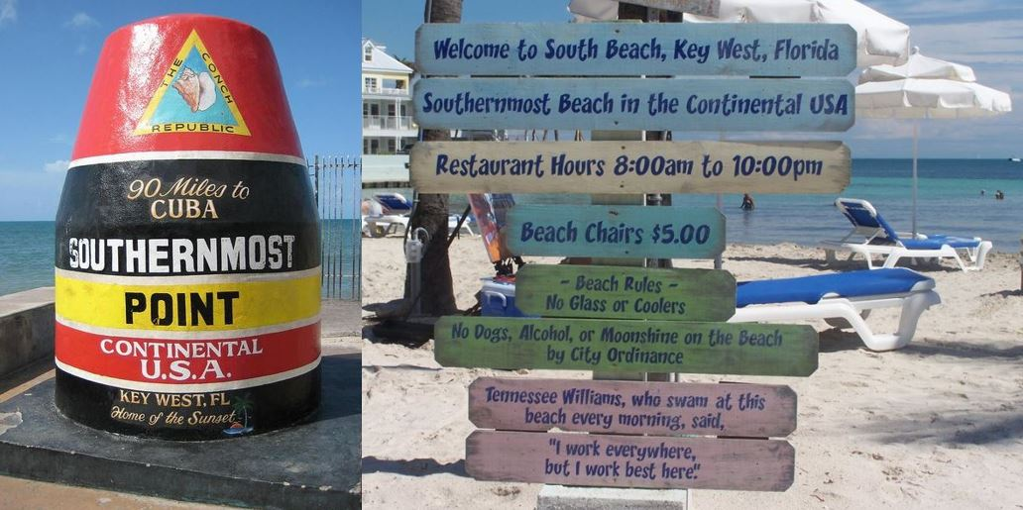
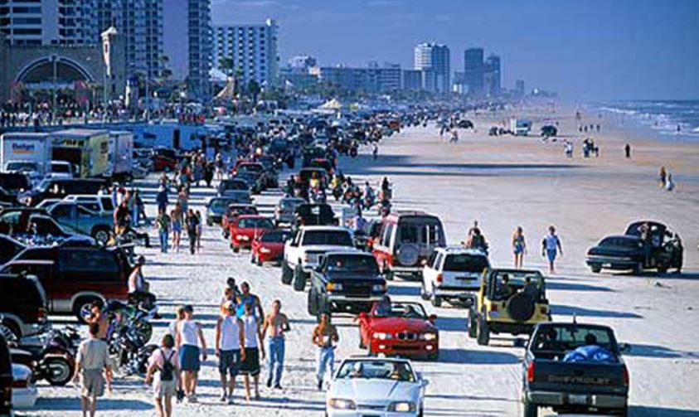
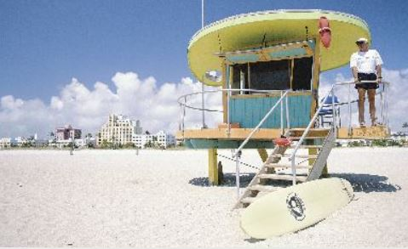
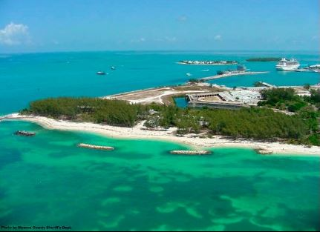
BEACHES
South Beach, Key West, FL
Daytona Beach, Daytona Beach, FL
South Beach, Miami, FL
Fort Taylor Beach, Key West, FL
Cocoa Beach, Cocoa Beach, FL

Slide 10
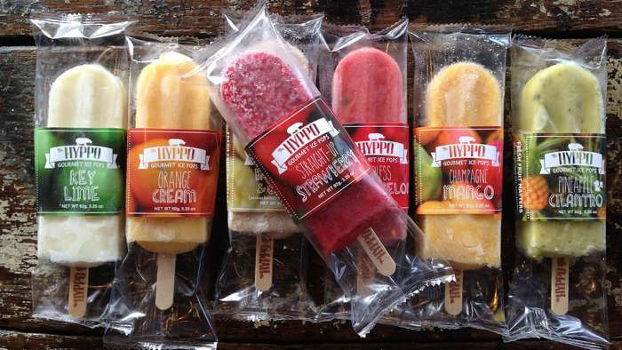
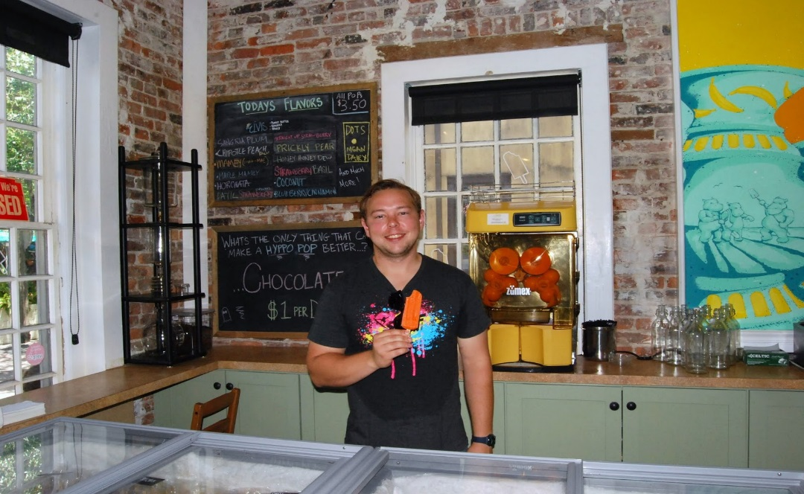
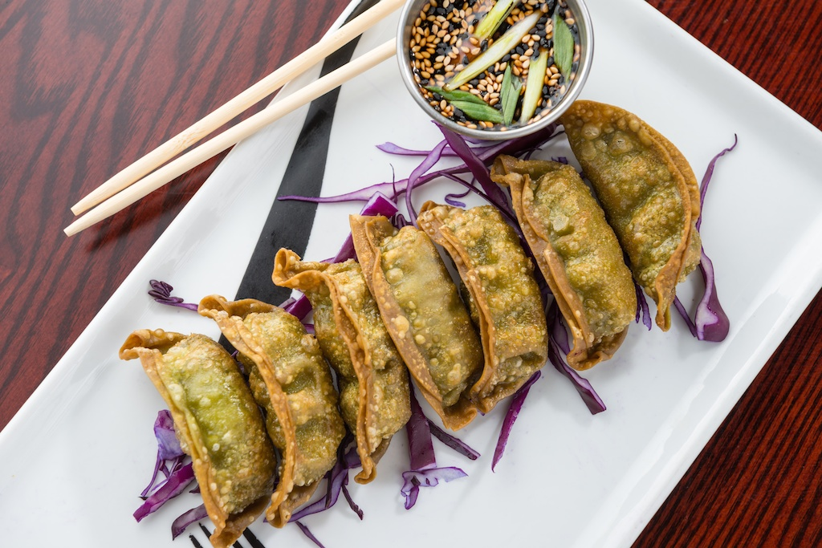
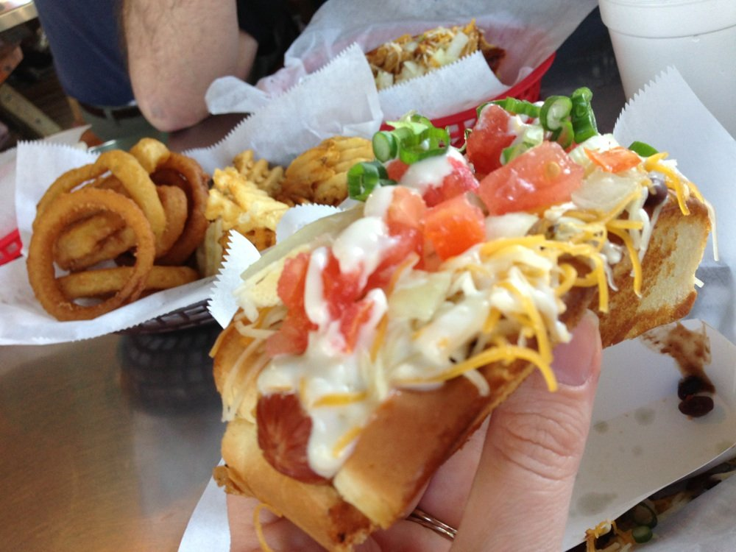
Hyppo Gourmet Ice Pops, St. Augustine and Gainesville, FL
Florida Foods
The Café, Key West, FL Dune Dog Café, Jupiter, FL

